Slide 1


micro:bit robot entry tutorial
Lesson 6
micro:bit robot lesson 6 “Avoid obstacle”
YahBoom micro:bit video tutorial

Slide 2
micro:bit robot entry tutorial
Content
Part1
Part 2
Part3
Part 4
Part 5
Learning goals
Preparation
Search for blocks
Combine blocks
Attentions
YahBoom micro:bit video tutorial

Slide 3
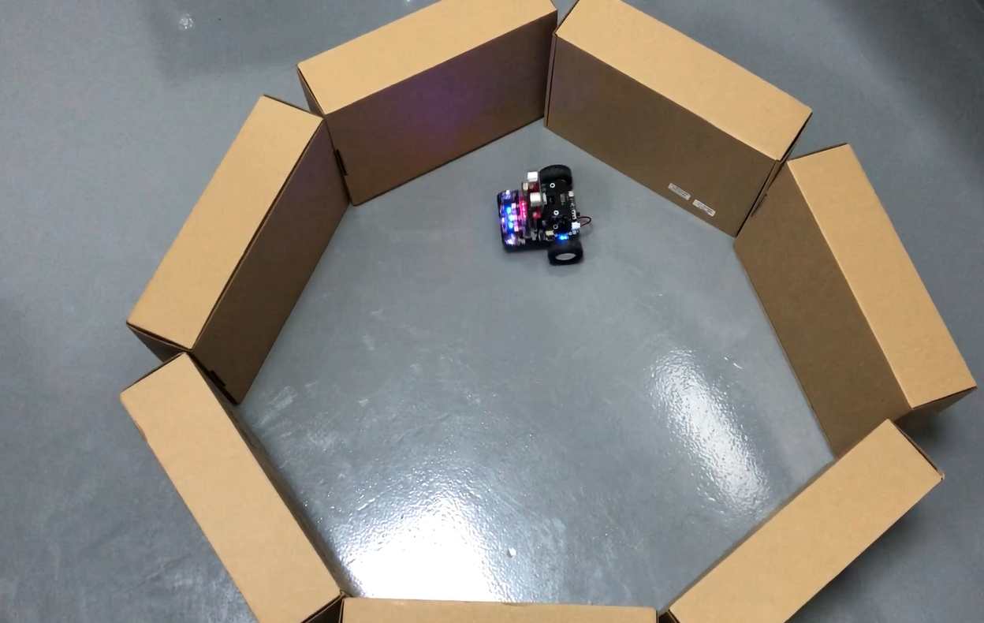
micro:bit robot entry tutorial
Part 1
Learning goals
Children, what we learn in this lesson is robot infrared obstacle avoidance. We can set up a roadblock to the front of the robot (or a loop of cartons for a robot to run inside), and then we can see that the robot will go all the way, and if there are obstacles in front of the robot, it will escape the barrier. The kids do it together.
YahBoom micro:bit video tutorial

Slide 4
micro:bit robot entry tutorial
Part 2
Hardware:
● 1 X USB cable
● 1 X micro:bit robot
Preparation
Then the micro:bit is connected to the computer through USB, and the computer will pop up a U disk and click the URL in the U disk to enter the programming interface. Input this URL https://github.com/lzty634158/yahboom_mbit_en to get the package.
YahBoom micro:bit video tutorial

Slide 5
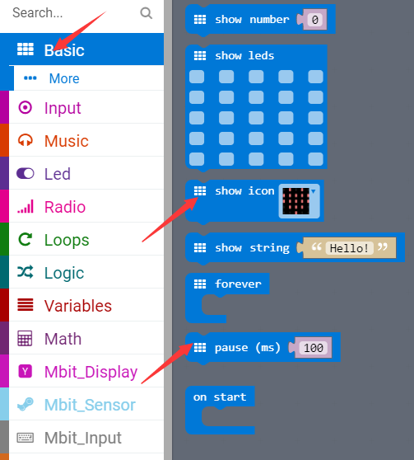
micro:bit robot entry tutorial
Part 3
Search for blocks
YahBoom micro:bit video tutorial

Slide 6
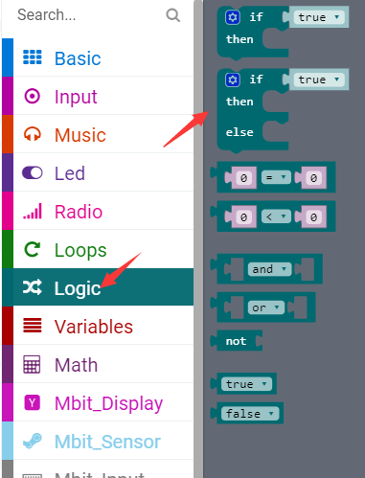
micro:bit robot entry tutorial
Part 3
Search for blocks
YahBoom micro:bit video tutorial

Slide 7
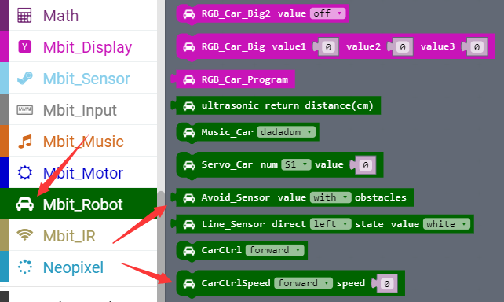
micro:bit robot entry tutorial
Part 3
Search for blocks
YahBoom micro:bit video tutorial

Slide 8
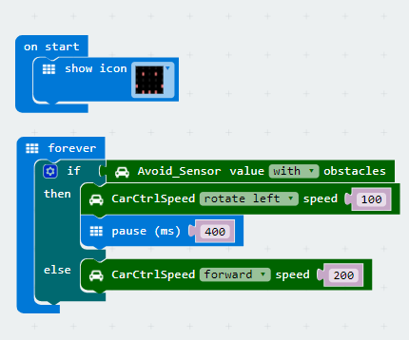
micro:bit robot entry tutorial
Part 4
Combine blocks
YahBoom micro:bit video tutorial

Slide 9
micro:bit robot entry tutorial
Part 5
1.This experiment must be carried out indoors to reduce interference from sunlight to infrared receiver.
2. Note:Because the infrared obstacle avoidance function of the car uses P3 (infrared receiver) and P9 pin (infrared emission) of the micro:bit board. They are multiplexed with the pins of the micro:bit dot matrix. During the experiment, some LED lights on the dot matrix may flicker.
Attentions
YahBoom micro:bit video tutorial

Slide 10
micro:bit robot entry tutorial
robot
lesson
Thanks for watching！
Powered by YahBoom
YahBoom micro:bit video tutorial

